Slide 1
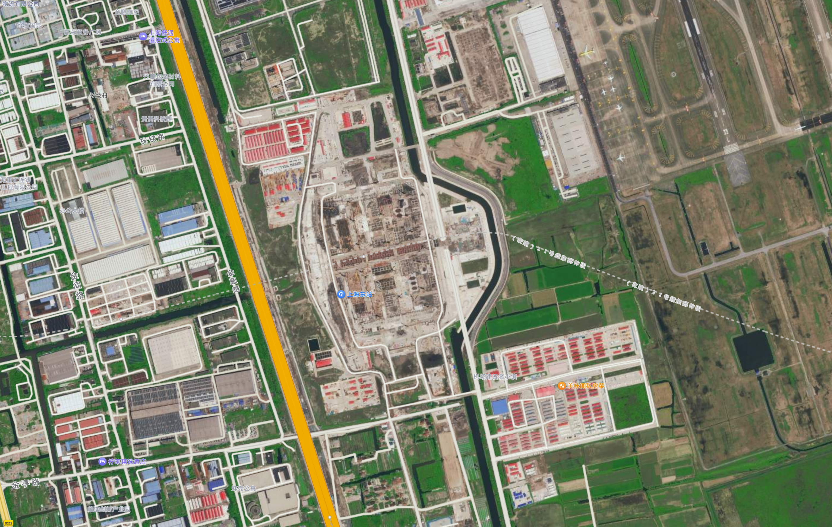
Airport area
Residential area
Slope
Important roads nearby

